Slide 1

Q3 2024
SHAREHOLDER ENGAGEMENT CALL
October 17, 2024

Slide 2

DISCLAIMER: This material in this presentation has been prepared by Southern Bancorp, Inc. (“SBI” or “the Company”) to engage with and inform its current shareholders about the activities of the Company. This presentation includes general background and summary information about SBI’s past, present and potential future activities. Nothing herein shall be construed as a representation or warranty by SBI or any other party. The information, including financial information, contained herein may not be interpreted as binding or guaranteed with respect to past, present or future results or operations. This information is given in summary form and does not purport to be complete. Information in this presentation, including financial information, should not be considered as advice or a recommendation to investors or potential investors in relation to holding, purchasing or selling securities or other financial products. This document does not represent and should not be interpreted to include, an offer of securities of any kind.
This presentation may contain forward looking statements including statements regarding our intent, belief or current expectations with respect to SBI’s businesses and operations, market conditions, results of operation and financial condition, capital adequacy, specific provisions and risk management practices. Readers are cautioned not to rely on these forward looking statements. As SBI is not a publicly traded company, it is neither required to nor does it undertake any obligation to publicly release the result of any revisions to these forward looking statements to reflect events or circumstances after the date hereof that reflect the occurrence of unanticipated events. Any forecasts and hypothetical examples used herein are subject to uncertainty and contingencies outside SBI’s control. Further, past performance is not a reliable indication of future performance.

Slide 3
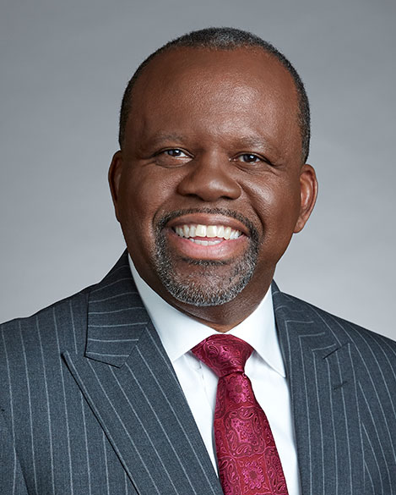
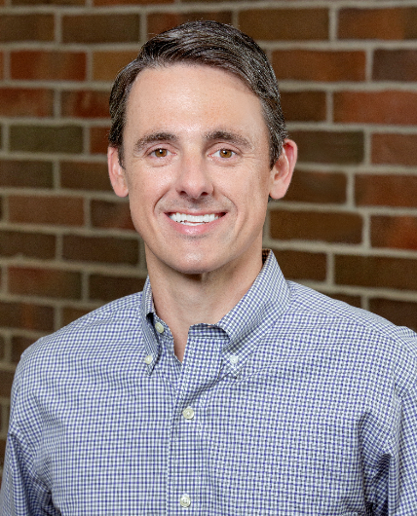
Profits Through Purpose
Executive Leadership on This Call
Darrin Williams
Southern Bancorp, Inc. CEO
Collins Cook
Southern Bancorp, Inc. Controller

Slide 4
We are Wealth Builders for EVERYONE.
THE GOLDEN CIRCLE
WHY
We believe that wealth building isn’t just for the
wealthy. We were founded to INVEST in
under-capitalized communities, and people’s dreams.
We are wealth builders for everyone.
HOW
We combine the strength of a multi- billon dollar bank with
the flexibility of a non-profit financial education and
development company to EMPOWER our customers
and communities.
WHAT
Southern Bancorp is a bank...and so much more. We
offer financial products and services that improve
financial health and TRANSFORM lives.

Slide 5
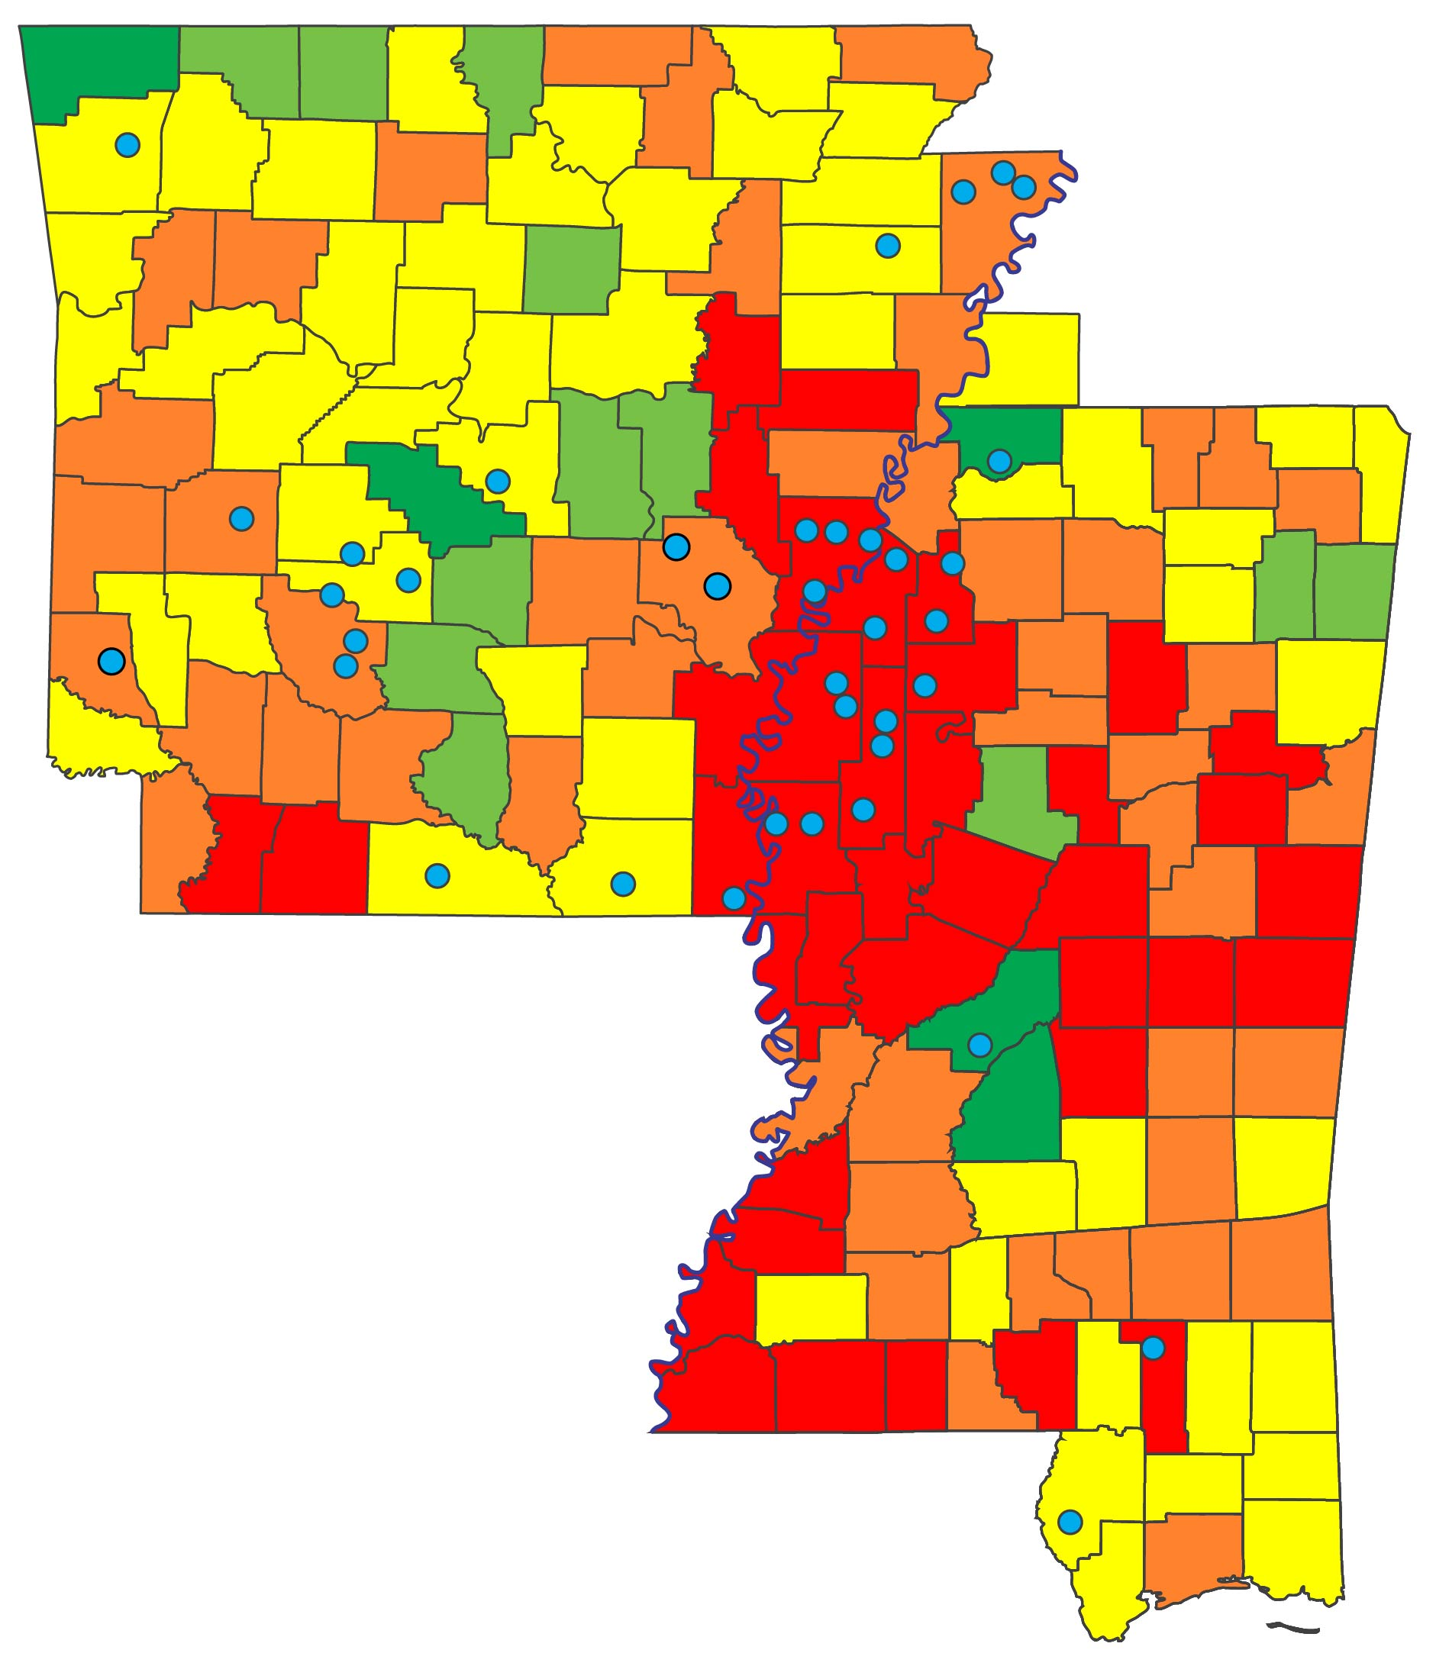
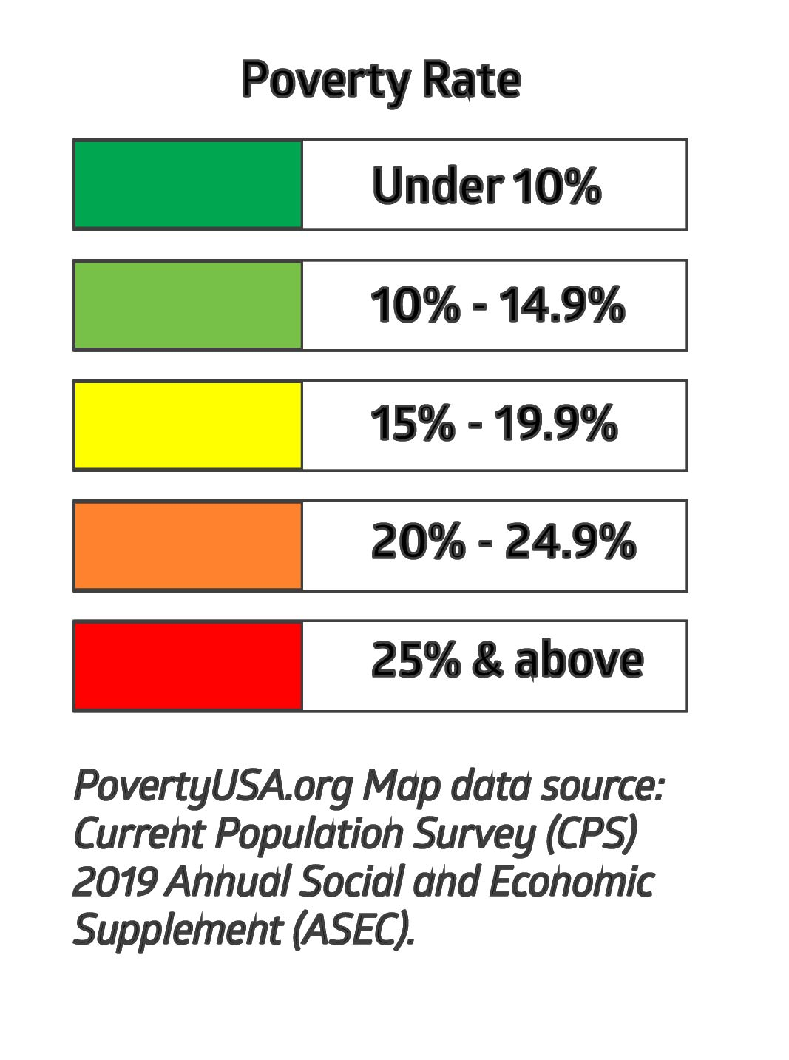
Providing Access to Credit in CDFI Targeted Underserved Communities
SBB 2024 | Q3 YTD
% of loans (#) to CDFI target markets | 83.09%
% of loans ($) to CDFI target markets | 75.56%
Loans originated (#) | 4,518
Loan originations ($ millions) | $634.56M
% of loans under $10,000 | 43.03%
# of loans under $1,000 | 282
Loans in persistent poor counties Q3 YTD:
% of all loans made:
1,633 loans Total: $177.80M
36.14% (#) 28.02% ($)

Slide 6
Financial Highlights
Q3
(Millions)
Q3
Q3
(Millions)

Slide 7
Q3 Financial Highlights YOY –
Balance Sheet (000’s)
 | 2023 |  | 2024
Cash & Investments | $804,209 |  | $834,440
Net Loans | $1,553,319 |  | $1,708,123
Fixed Assets | $41,676 |  | $43,821
Intangibles | $59,201 |  | $58,551
Other Assets | $123,214 |  | $126,216
TOTAL ASSETS | $2,581,619 |  | $2,771,151
Deposits | $1,926,224 |  | $2,032,737
Other Borrowings | $210,563 |  | $260,332
Other Liabilities | $19,554 |  | $23,839
Shareholder's Equity | $425,278 |  | $454,243
TOTAL LIABILITIES & EQUITY | $2,581,619 |  | $2,771,151

Slide 8
Q2 Financial Highlights YOY –
Income Statement (000’s)
 | 2023 |  | 2024
Interest Income | $27,905 |  | $34,549
Interest Expense | ($8,053) |  | ($12,782)
Net Interest Revenue | $19,852 |  | $21,767
PLLL | $(300) |  | --------
Non Interest Income | $3,410 |  | $3,555
Non Interest Expense | ($19,184) |  | ($22,455)
Income Before Taxes | $3,778 |  | $2,867
Taxes | ($781) |  | $539
Net Income | $2,997 |  | $3,406

Slide 9
Q3 Financial Highlights YTD – Income Statement (000’s)
 | 2023 |  | 2024
Interest Income | $79,205 |  | $98,243
Interest Expense | ($18,979) |  | ($34,734)
Net Interest Revenue | $60,226 |  | $63,509
PLLL | ($900) |  | ($650)
Non Interest Income | $10,162 |  | $10,443
Non Interest Expense | ($56,652) |  | ($62,886)
Income Before Taxes | $12,836 |  | $10,416
Taxes | ($1,891) |  | $54
Net Income | $10,945 |  | $10,470

Slide 10
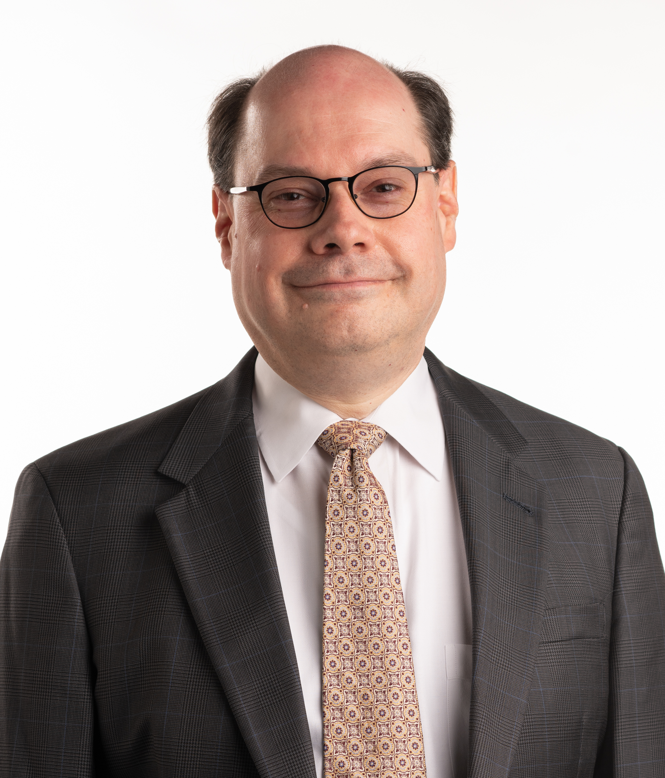
Newly Appointed to our Board of Directors
Eduardo R. Ochoa, Jr., MD, FAAP
Southern Bancorp Bank Board of Directors
Professor with Tenure
Vice Chair of Diversity and Health Equity, Department of Pediatrics
University of Arkansas for Medical Sciences
Arkansas Children’s Hospital

Slide 11

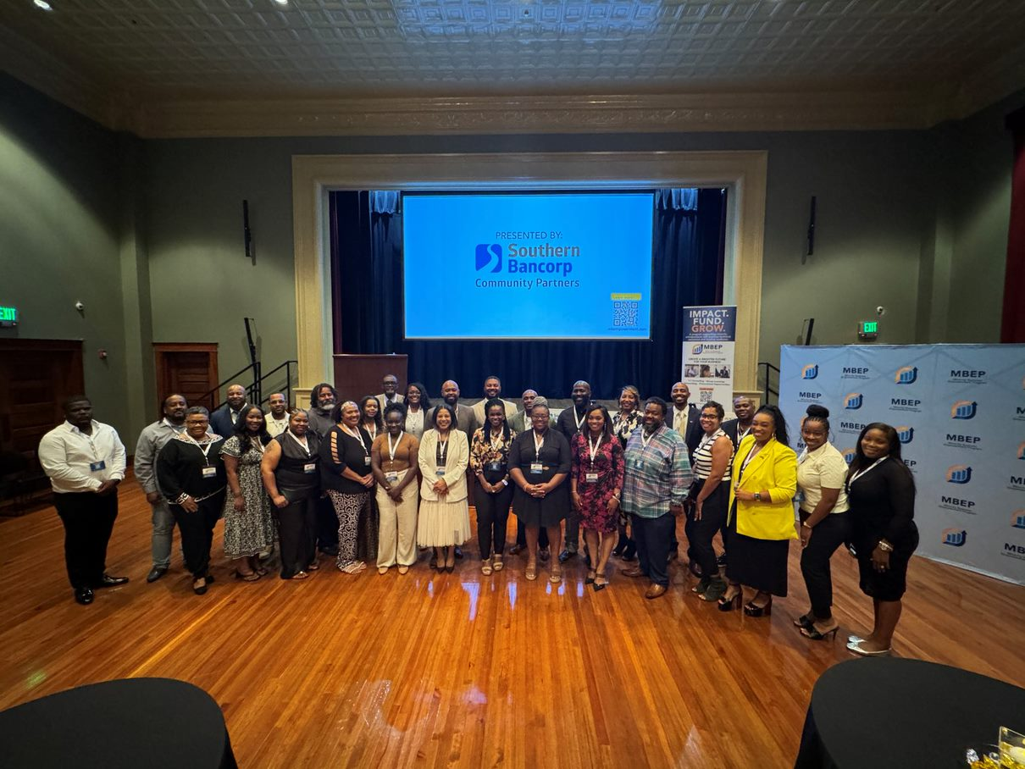


A specialized 12-week program empowering minority-owned businesses through training, resources, and networking opportunities with a focus on enhanced business acumen, growth, and success in their respective industries.
2024 Fall Cohort
Our Funding Partners

Slide 12

Emergency Capital Investment Program
Southern Bancorp to save $1.875 MLN in annual dividend payments by increasing its qualifying loan originations to its Target Market in the first year dividends are required under the ECIP.
Mission Impact: | The $250 MLN ECIP investment comes with incentives for Southern to expand lending to target communities, as defined by underserved people, places, projects and businesses.
Margin Impact: | The more “qualified” or “deep impact” lending originated, the lower dividend rate paid on the ECIP capital.
Timing: | Closed July 2022; two years of no dividend payments Originations start to count toward dividend reduction July 2023 - June 2024 Dividend payments begin in Q3 2024, paid every quarter

Slide 13

How It Works:
Increasing “Qualified” and “Deep Impact” Lending to “Target Communities”
PLACES
Rural communities | Minority communities
Urban low income communities | Persistent Poverty Counties
Underserved communities | Indian Reservations and US Territories
$250 MLN
Equity
Investment
PEOPLE
Moderate income borrowers (80-120% AMI) | Low-income borrowers (<80% AMI)
Loans to minorities | Mortgages to minorities
PROJECTS
Affordable housing | Deeply affordable housing
Community development | Community development primarily benefit low income or minority individuals or businesses
Community facilities
Note: Borrowers and/or projects in regular font are categorized as “qualified lending.” Items in BOLD are categorized as “deep impact”
BUSINESSES
Small businesses or farms (annual revenues <$1M) | Underserved small business (annual revenue <$100K and/or low income/minority owner(s)

Slide 14

FY 2024 CDFI Fund Program Awards announced in Q3 2024
Southern Bancorp received:
  Bank Enterprise Award (BEA): $163,012
  Financial Assistance Award (FA): $1,285,000
Total: $1,448,012

Slide 15
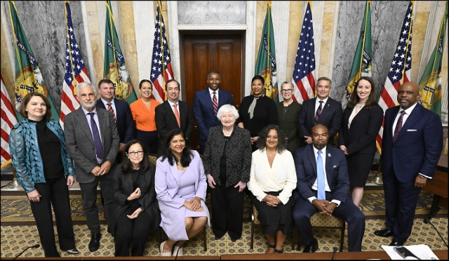
Celebrating 30 Years of the CDFI Fund
The Riegle Act, which created the CDFI Fund, was signed into law on September 23, 1994, by President Bill Clinton
Since its creation, the CDFI Fund has awarded more than $7 billion to CDFIs and community lenders and $76 billion in tax credits to community development entities. Every dollar the CDFI Fund invests is estimated to catalyze at least eight dollars in private-sector investment, magnifying its impact.
- US Treasury Secretary Janet Yellen, September 19, 2024

Slide 16

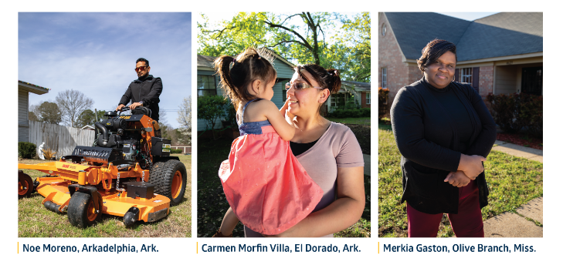
Mission-Driven Deposits
Where does your money spend the night?
Organizations rarely question how their deposits are put to work. Are those deposits supporting loans that align with your organization’s beliefs? Are they helping lift-up families? If your deposits are with Southern Bancorp, then they are helping fulfill our mission to narrow America’s homeownership gap and break the cycle of generational poverty.

Slide 17
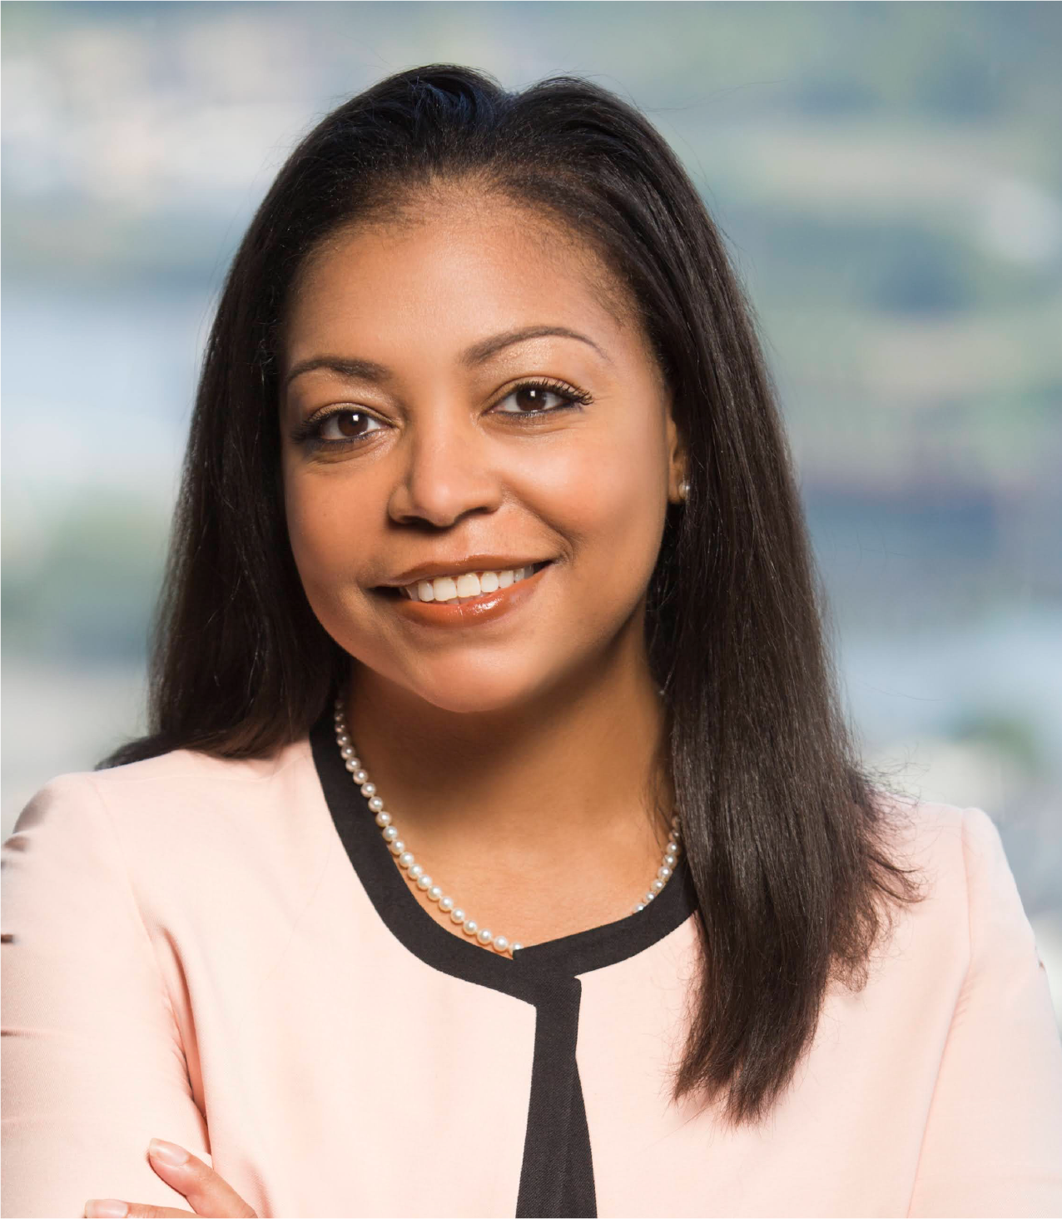
Q & A
SAVE THE DATE:
Q4 2024 Shareholder Engagement Call
Thursday, January 16th, 2025
9:30 am CST
Visit banksouthern.com/investors
All investor questions can be directed to
Kenya Davenport, SVP Stakeholder Engagement
Kenya.Davenport@banksouthern.com |(501) 501-492-3493 |TF (800) 789-3428
Kenya Davenport

Slide 18




BankSouthern.com
SouthernPartners.org
southernbancorp
@southernbancorp
@southernbancorp
southern
Company/southern-bancorp

